Slide 1

Welcome to Predictive Modeling: Evaluating Graduation Outcomes for College Students OESON
Presented by : Adan Abdullahi

Slide 2
Problem Statement
We have student dataset includes a range of personal details, academic history, and demographic information, such as age, gender, previous qualifications, and more..
The goal of this project is to perform a detailed Exploratory Data Analysis (EDA) on the Student academic data set and build a predictive model that determines whether a college student will graduate or not.
The project aims to apply machine learning algorithms to create a predictive model. This model will use the data from past and current students to forecast whether a college student will successfully graduate or not.
We will evaluate and compare the performance of a minimum of five distinct machine learning algorithms. This comprehensive approach allows us to identify the most effective model for our specific task
To effectively communicate the model's performance, we will use visualization techniques such as confusion matrices and AUC-ROC curves. These visuals help in understanding the model's accuracy, precision, recall, and overall predictive capabilities.
Key Objectives:
Implement at least five machine learning algorithms.
Generate meaningful insights from the model's predictions.
Visualize model performance using confusion matrices and AUC-ROC curves.

Slide 3
TABLE OF CONTENTS
01
02
03
Pre-processing
Exploratory Data Analysis (EDA)
predictive modeling
Feature Scaling
Data Encoding
Train-Test Split
Model Selection
Hyperparameter Tuning
Model Evaluation
Data Cleaning
Outlier Handling
Feature Engineering

Slide 4
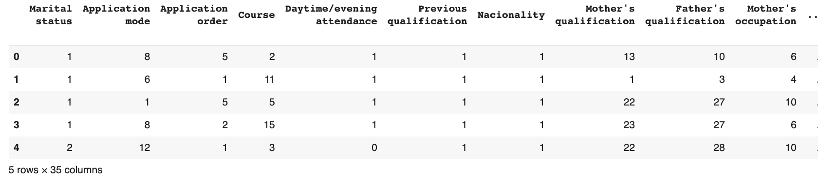
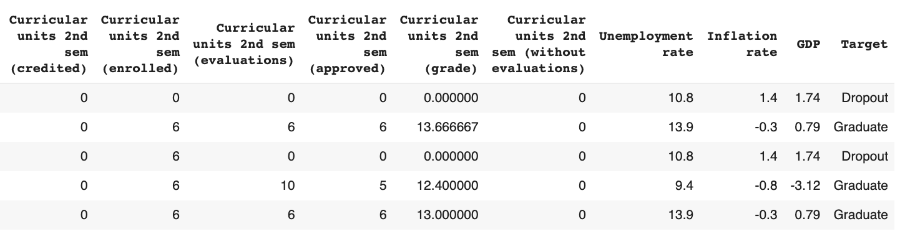
EDA
01
Displaying the first five rows of each dataset to understand their structure
We are working with a dataset that includes 35 columns and 4424 rows
focusing on college student data. For our analysis, we have selected a sample dataset that represents features such as "Marital status," "Application mode," "Application order," and more.
Our primary objective is to perform data preprocessing tasks, including identifying normal distributions in specific columns and removing outliers.

Slide 5
Data cleaning
Sstudent Dataset
Cleaning process
Contains 35 columns and 4424 rows
Handling
Missing Values
Removing
Duplicates
Correcting
Data Types
Handling
Outliers
Normalization
Data
Transformation

Slide 6
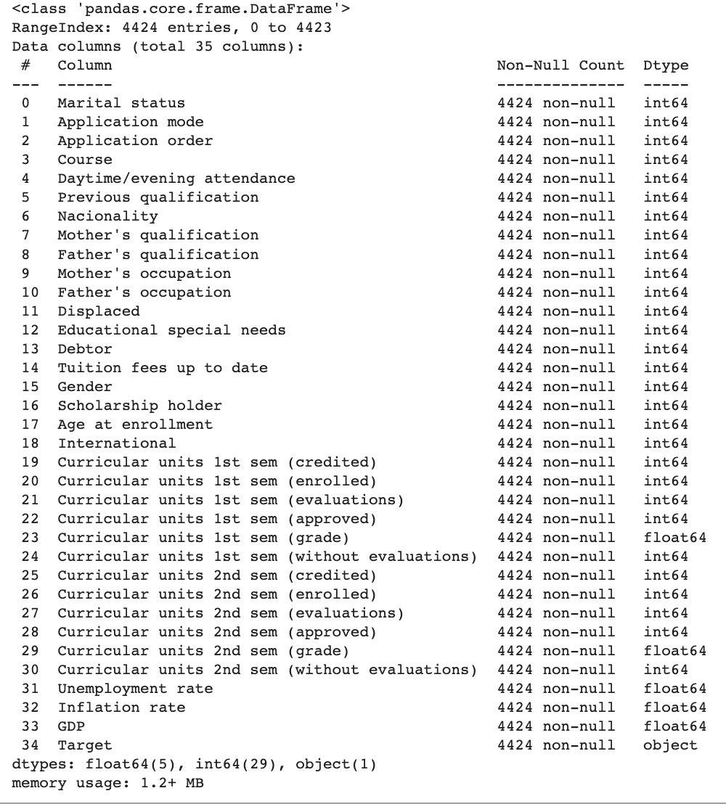
Handling Missing Values
Data Frame has 4424 rows and 35 columns
Data types in the Data Frame include integers floats, and a single object column
No missing values detected within the Data Frame
The Data frame consumes approximately 1.2+ MB of memory

Slide 7
Overview of Descriptive Statistics
The slide provides a comprehensive overview of descriptive statistics for 35 columns in the dataset.
The statistics presented include count, mean, standard deviation (std), minimum (min), 25th percentile (25%), median (50%), 75th percentile (75%), and maximum (max) values
These statistics offer insights into the central tendency, spread, and distribution of data for each column.
The dataset comprises 4,424 rows, each representing an individual student, and 34 columns, corresponding to diverse attributes and measurements.
Notable statistics for specific columns:
"Marital status" averaging 1.18 (ranging from 1 to 6), "Application mode" averaging 6.89 (ranging from 1 to 18), "Application order" averaging 1.73 (ranging from 0 to 9), "Course" averaging 9.90 (ranging from 1 to 17), and "Daytime/evening attendance" mostly around 0.89.

Slide 8
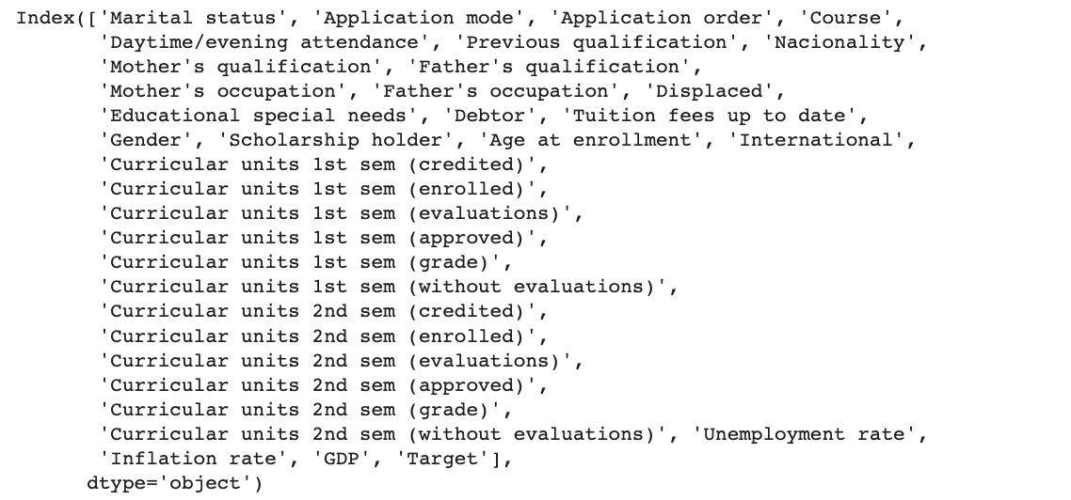
Overview of Dataset Columns
The dataset comprises 35 distinct columns, each corresponding to specific attributes related to the students in the dataset.
These columns encompass information about marital status, application mode, course details, attendance preferences, educational qualifications, nationality, and various other student-specific characteristics.
the dataset includes columns pertaining to the curriculum, covering credited courses, enrolled courses, course evaluations, approved courses, course grades, and courses without evaluations.
The dataset also incorporates columns associated with economic indicators, including the unemployment rate, inflation rate, and GDP.
Finally, the dataset contains the target variable 'Target' that signifies whether a student will graduate or not.

Slide 9
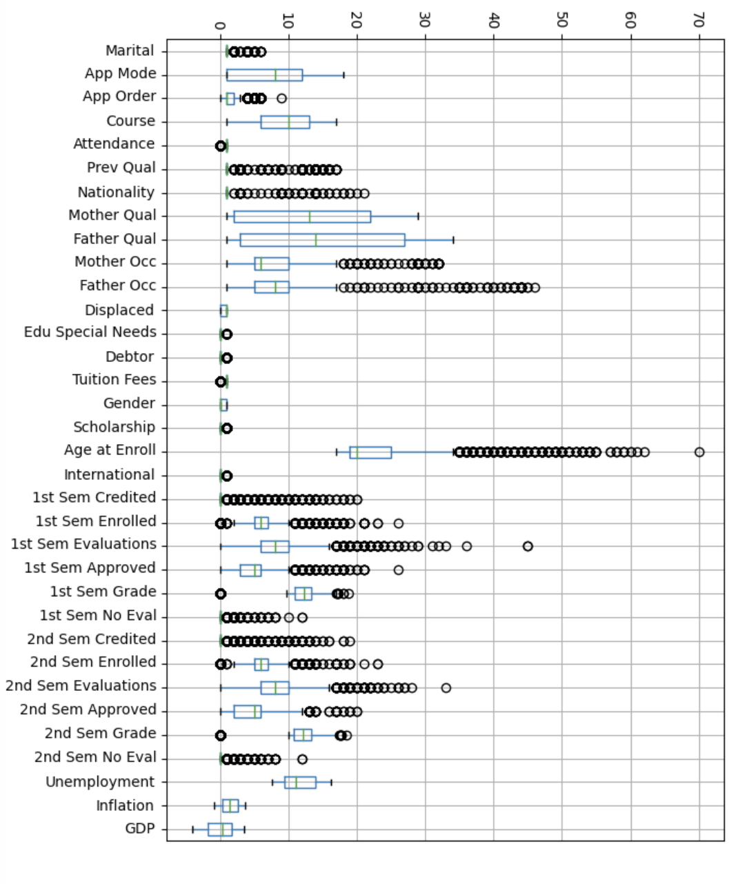
Outlier Detection
The "Application mode" column exhibits a relatively high outlier with a value of 11.0.
"Mother's qualification" and "Father's qualification" columns also contain outliers with values of 20.0 and 24.0, respectively.
Age at enrollment" displays an outlier with a value of 6.0.
Curricular units 1st sem (enrolled)" and "Curricular units 2nd sem (enrolled)" columns each have outliers with values of 2.0.
"Curricular units 2nd sem (grade)" exhibits an outlier with an average value of approximately 2.583.

Slide 10
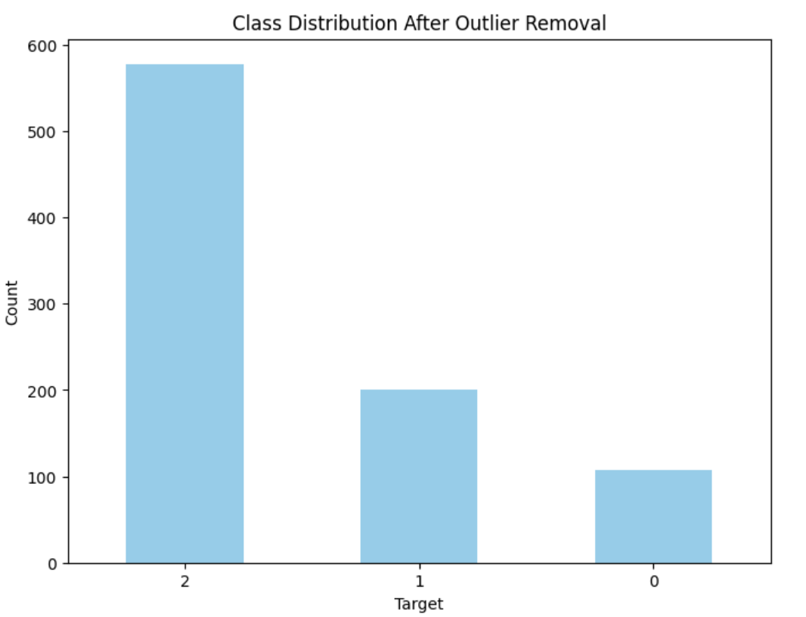
Enhancing Data Quality: Outlier Removal and Data Refinement
After removing outliers from the dataset, we are left with a more refined and cleaner dataset for analysis.
The distribution of the 'Target' classes has been updated, providing a more accurate representation of the data.
The 'Target' classes now have a more balanced distribution, which can improve the performance of machine learning models.
Outliers, which may have skewed the analysis and predictions, have been successfully identified and removed from the dataset.
With the outliers eliminated, the dataset is better prepared for further data preprocessing and the development of predictive models.

Slide 11
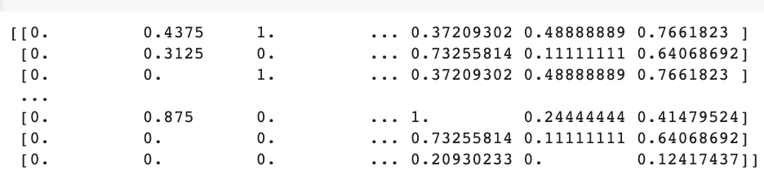
Pre-processing
02
Feature Scaling or data normalization
The provided dataset output has undergone normalization, a critical step in data preprocessing.
Normalization scales the values within a uniform range of 0 to 1, enabling machine learning models to interpret and compare attributes consistently.
This ensures a more reliable and robust performance in predictive modeling and data analysis

Slide 12
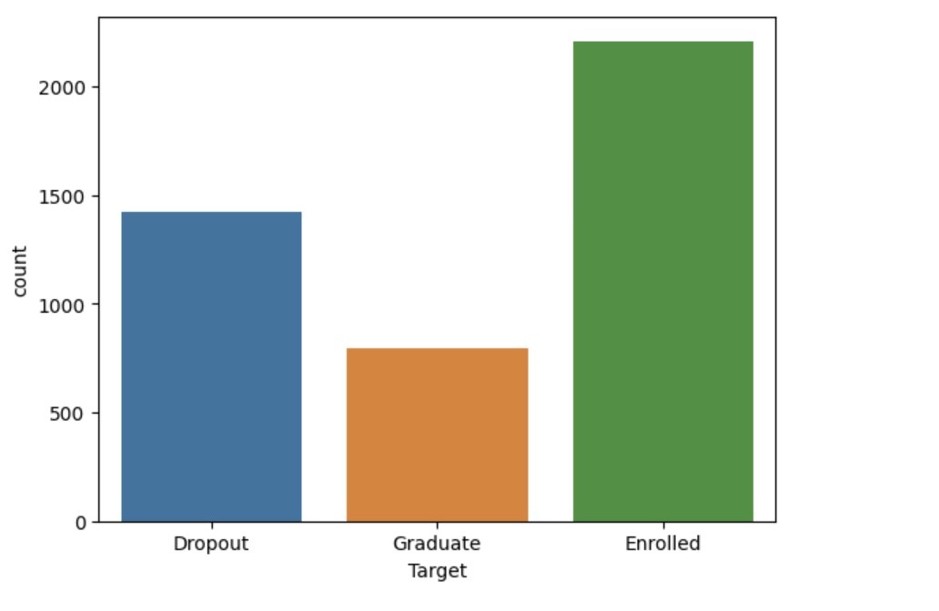
Visualizing Student Outcome Categories
This count plot visually represents the distribution of student outcomes within the dataset, providing an overview of the proportions of "Dropout," "Graduate," and "Enrolled" students.
The x-axis labels have been set to clearly indicate the three outcome categories: "Dropout," "Graduate," and "Enrolled," enhancing the interpretability of the plot.
By observing the count plot, we can easily identify the balance or imbalance in the dataset with respect to the different student outcomes.
This plot serves as a foundational step in the exploratory data analysis process, helping us gain insights into the data distribution.

Slide 13
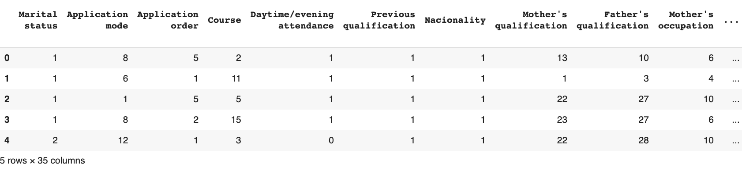
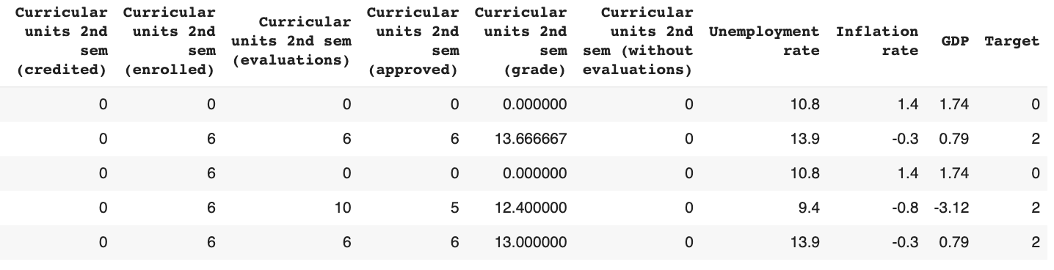
Data Encoding
Data encoding is the process of converting data from one format or representation to another format.
Label Encoding: assigns unique numerical labels to categories within a categorical variable, typically used for categorical data.
Label Encoder converted 'Target' into binary values (0 and 1).
Numeric format suits binary classification tasks.
'Target' is now ideal for training binary classification models.
Simplifies handling categorical data in machine learning.

Slide 14
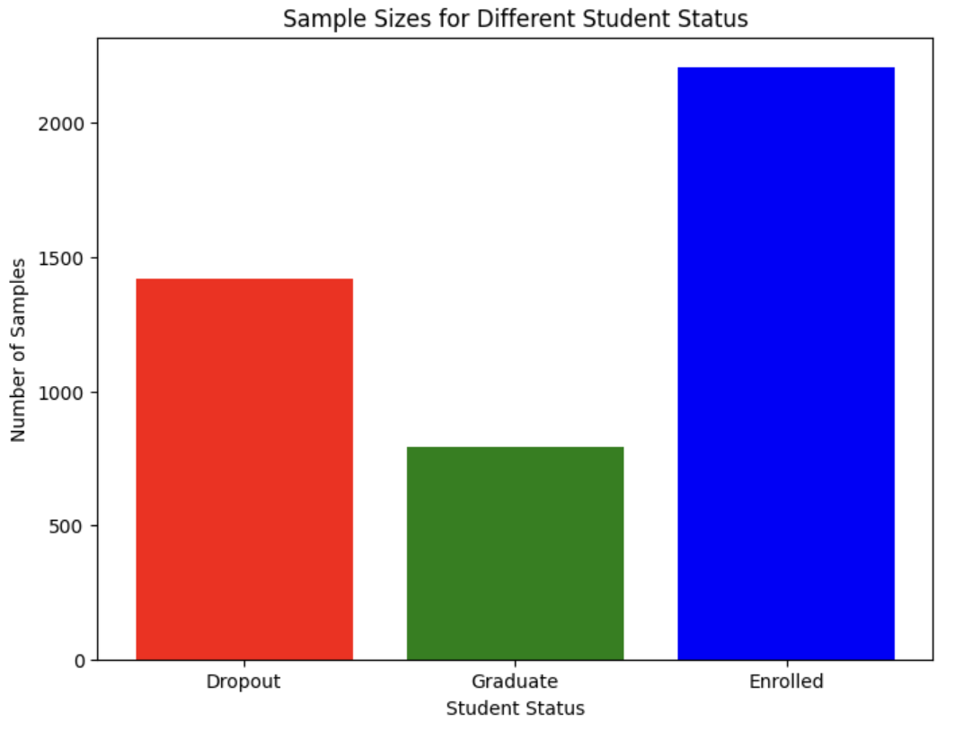
Analyzing Student Data - Class Distribution
Data Imbalance: The class distribution plot reveals a notable data imbalance among different student categories.
The dataset consists of 1,421 "Dropout" records, 794 "Graduate" records, and 2,209 "Enrolled" records.
Enrollment Prevalence: The "Enrolled" category significantly outnumbers "Dropout" and "Graduate" categories, indicating a larger population of enrolled students in the dataset.
Challenges and Considerations: Addressing data imbalance is vital when applying machine learning algorithms to ensure equitable model performance, given the disparities among the classes.
Potential Bias: The skewed distribution may introduce bias in model predictions, necessitating techniques like resampling or reweighting to handle the varying class sizes.

Slide 15
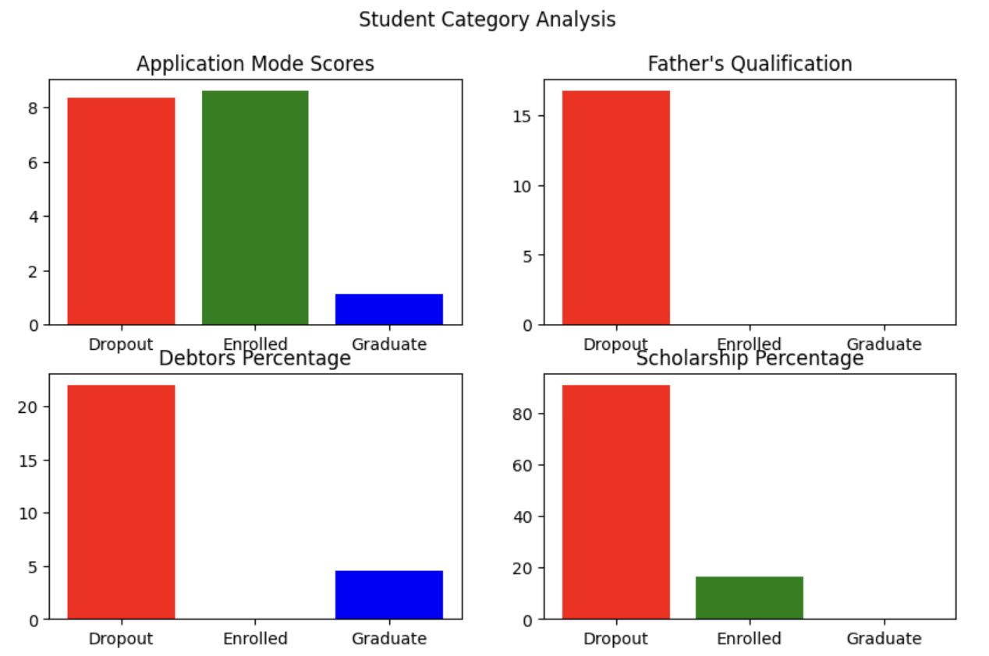
Student Category Analysis
Dropout: Higher "Application mode" scores and more "Father's qualification." Most are not "Scholarship holders," and a significant portion are "Debtors."
Enrolled: Varied "Father's occupation" and higher "Tuition fees up to date." Mix of "Scholarship holders" and a significant percentage are "Displaced."
Graduate: Higher "Marital status," lower likelihood of "Educational special needs." Most are not "Debtors" and have diverse "Course" preferences.
Utilization: These insights guide tailored support and interventions for each student category, enhancing educational experiences.

Slide 16
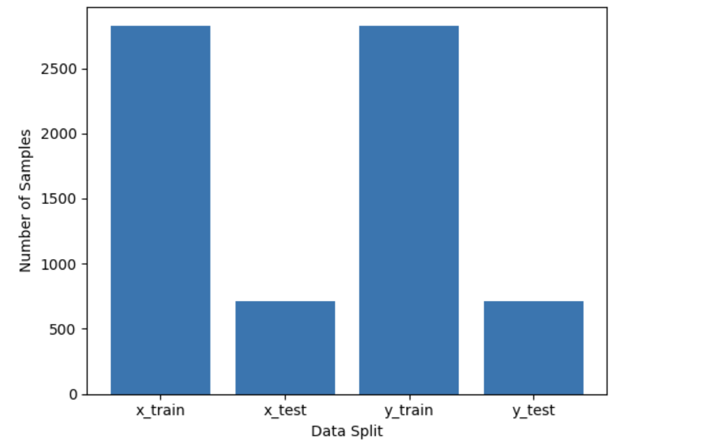
Separate X Data and Y Data
Data Split: We have divided our dataset into training and testing data to facilitate model development and evaluation.
X Data: The training data, denoted as "x_train," consists of features or independent variables used to train our machine learning model.
Y Data: The corresponding training labels, denoted as "y_train," represent the target variable that our model aims to predict.
Testing Data: The testing data, represented by "x_test" and "y_test," serves as an independent dataset to evaluate the model's performance.
Balanced Split: Ensuring a balanced and representative split is crucial for building and testing robust machine learning models.

Slide 17
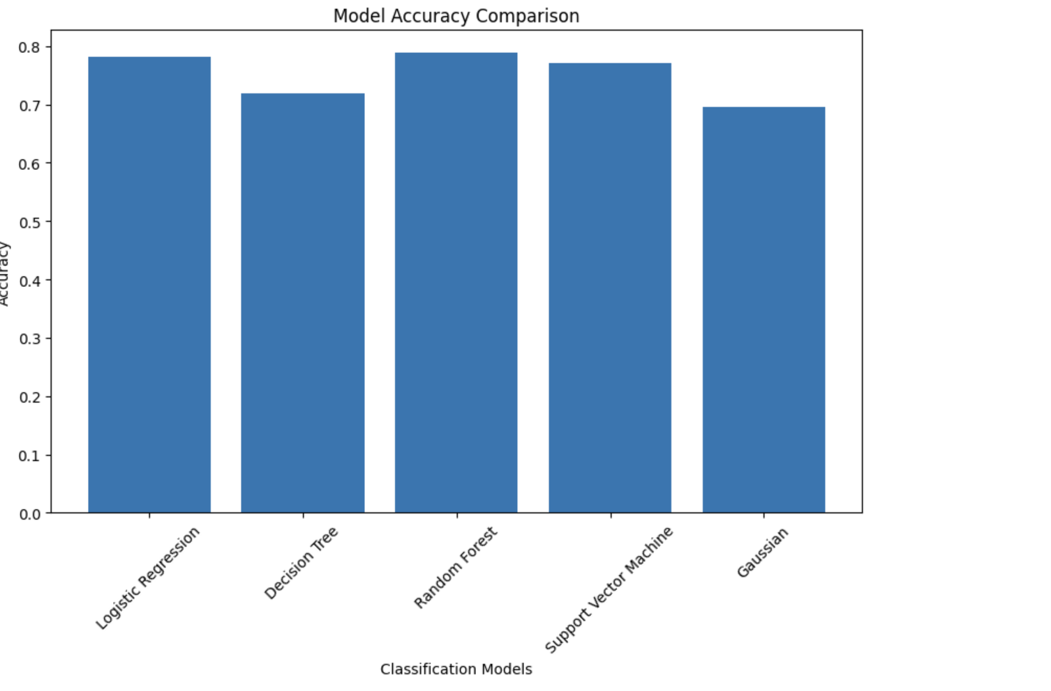
predictive modeling
Model Training-selection:
We have chosen five classification algorithms for our analysis, each with unique strengths:
Logistic Regression achieved the highest accuracy at 78%, making it the top choice for predicting graduation outcomes
Decision Tree showed an accuracy of 75% and is a strong contender for predicting graduation.
Random Forest had an accuracy of 77%, providing reliable predictions for graduation.
Support Vector Machine (SVM) yielded an accuracy of 76% and is a valuable model for determining graduation.
Gaussian Naive Bayes (GaussianNB) had the lowest accuracy at 70%, indicating its limited suitability for graduation predictions

Slide 18
Model Evaluation and Performance Metrics
Confusion Matrix: Visualizes model performance for Dropout, Graduate, Enrolled classes.
Accuracy: Overall model accuracy at 69%.
Precision: 0.76 for Dropout, 0.27 for Graduate, 0.76 for Enrolled.
Recall: 0.68 for Dropout, 0.24 for Graduate, 0.84 for Enrolled.
F1-Score: Balances precision and recall: 0.72 for Dropout, 0.25 for Graduate, 0.80 for Enrolled.
The model shows promising performance in distinguishing student outcomes, with high precision and recall for "Enrolled" students,

Slide 19
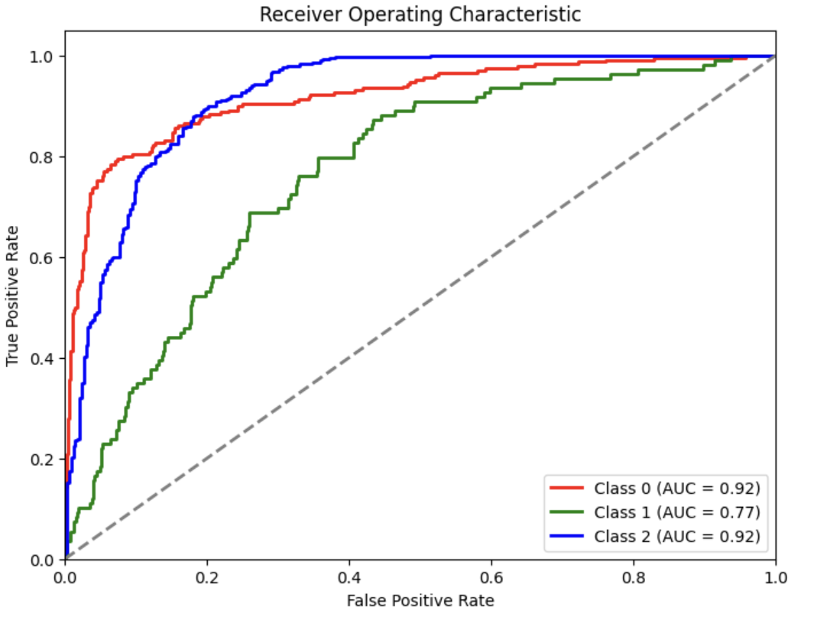
Model Evaluation Using ROC Curves and AUC
ROC Curves: This analysis employs ROC curves to evaluate the model's performance for each class (Dropout, Graduate, Enrolled), illustrating the trade-off between sensitivity and specificity.
AUC: The AUC values for each class (0.85, 0.78, 0.84) indicate the model's ability to distinguish between classes. Higher AUC values suggest better predictive accuracy.
Class-Specific Evaluation: The ROC curves and AUC are presented for each class, providing insights into how well the model performs for individual student categories
Receiver Operating Characteristic: The ROC curves visually represent the model's true positive rate against the false positive rate, aiding in the assessment of classification performance.

Slide 20
Conclusion
Based on our findings, we have employed five machine learning algorithms, each with its unique strengths, to create a predictive model for determining whether a college student will graduate or not. These models have undergone extensive evaluation, including the use of ROC curves and AUC values, as well as the examination of confusion matrices.
Our analysis suggests that while no model is perfect, Logistic Regression has demonstrated the highest accuracy among all the algorithms with an accuracy of 78%. This indicates that Logistic Regression is the most reliable algorithm for predicting student graduation, based on the data and features used in this study.
On the other hand, Gaussian Naive Bayes, with an accuracy of 70%, showed the lowest performance among the five algorithms.
From the ROC curves and AUC values, we can conclude that all models have the capability to distinguish between different student categories, albeit with varying degrees of accuracy.

Slide 21

